Slide 1

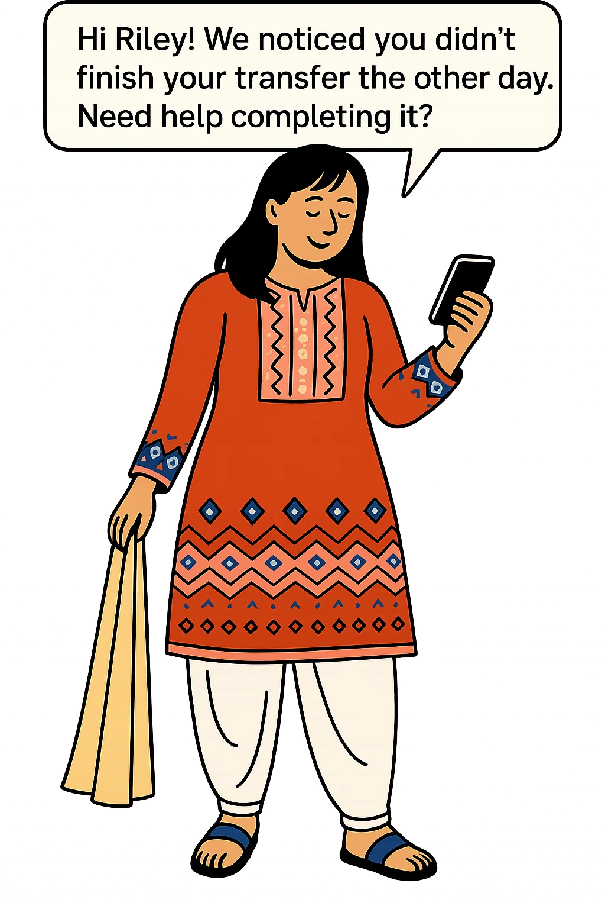





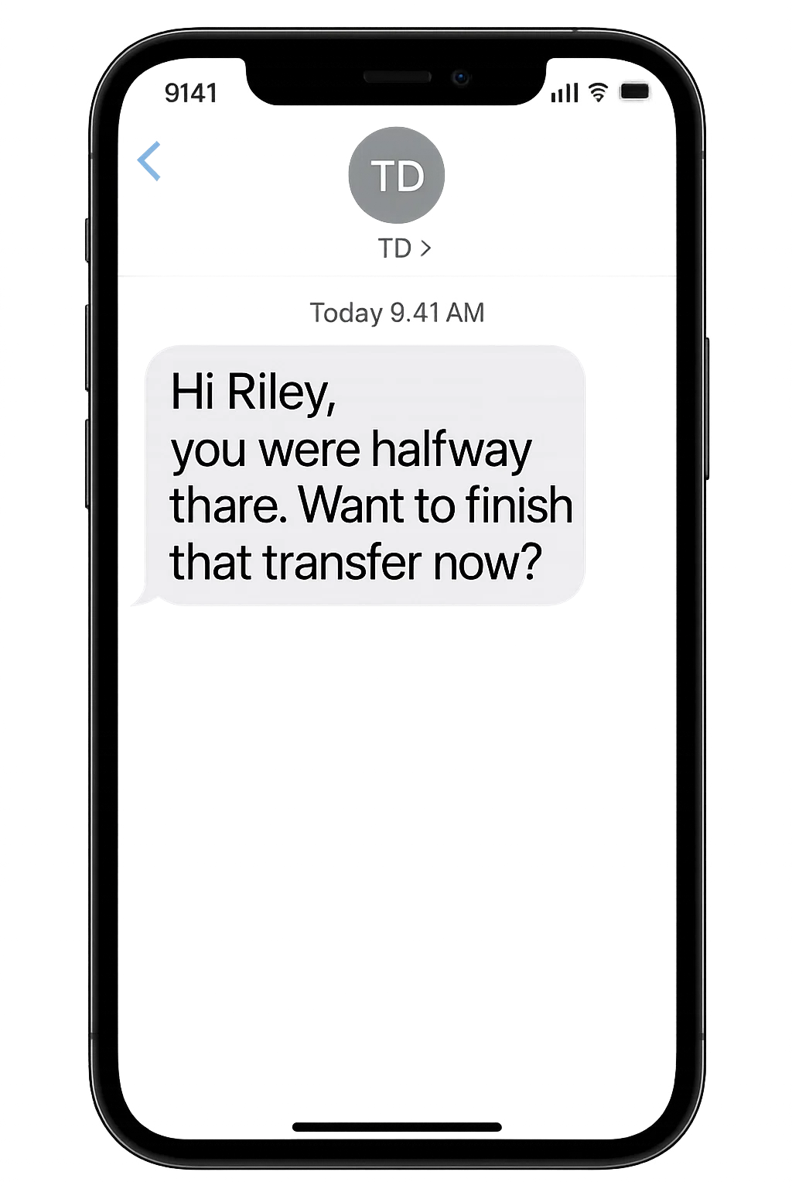


ChimeIn | Abandoned Transfer Recovery
Meet Riley - Riley is a Gen Z student juggling part-time work and school. She prefers digital banking for its convenience. One evening, Riley begins a $500 transfer to her landlord—but gets distracted and never completes it.
1
Riley receives a notification…
5
 | https://sora.chatgpt.com/g/gen_01 jvwrf811f4btq74ds0rnqmt0 |  | Riley completes her unfinished transfer in branch Her Digital Readiness Score improves from assisted completion Advisor saves time by avoiding redundant intake Branch interaction feels personalized and context-aware Riley’s trust and satisfaction increase—she feels seen, not sold to + Data & Analytics
Riley enters the Branch…
A day passes and Riley has not completed the transfer…
2
3
The system surfaces the context to the concierge through ChimeIn
6
ChimeIn schedules an SMS
The concierge approaches Riley…
7
4
I saw you started a transfer last week—want me to walk you through the last step?
Riley receives an SMS message …
8
Riley decides to go home and complete it
Riley completes the transaction
Notes:
Riley starts a $500 transfer online but doesn’t finish it. Later, when she visits the branch, MCP (Model Context Protocol) recognizes the incomplete task and surfaces it to the advisor in real time.
The AI business rules engine triggers a gentle mobile nudge and notifies staff:
“Riley didn’t complete her transfer—ask if she’d like help finishing it.”
The advisor offers to assist. Riley chooses to go home and complete the task online. If she hadn’t, an SMS follow-up would’ve been sent automatically via the same orchestration logic.
This journey avoids duplicate effort, supports the customer in the right moment, and makes the experience feel personal and helpful—not transactional.

Slide 2

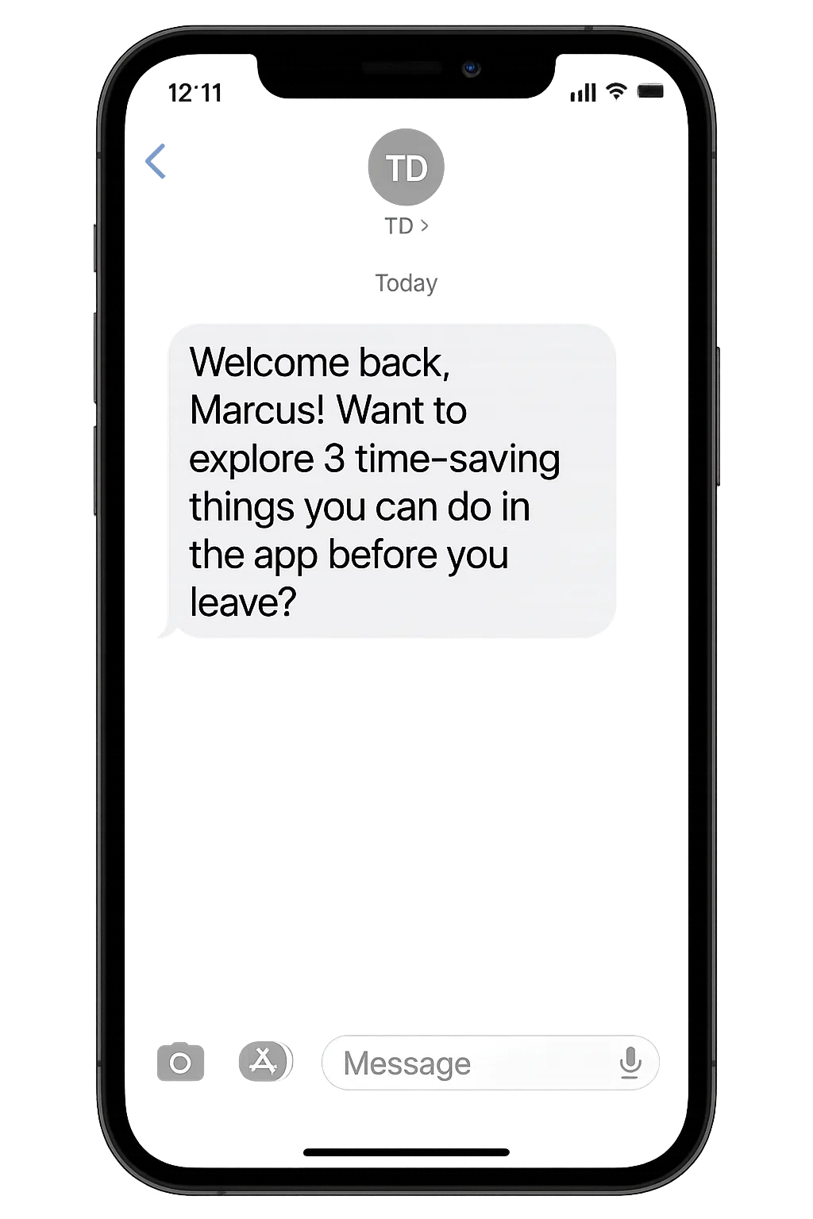
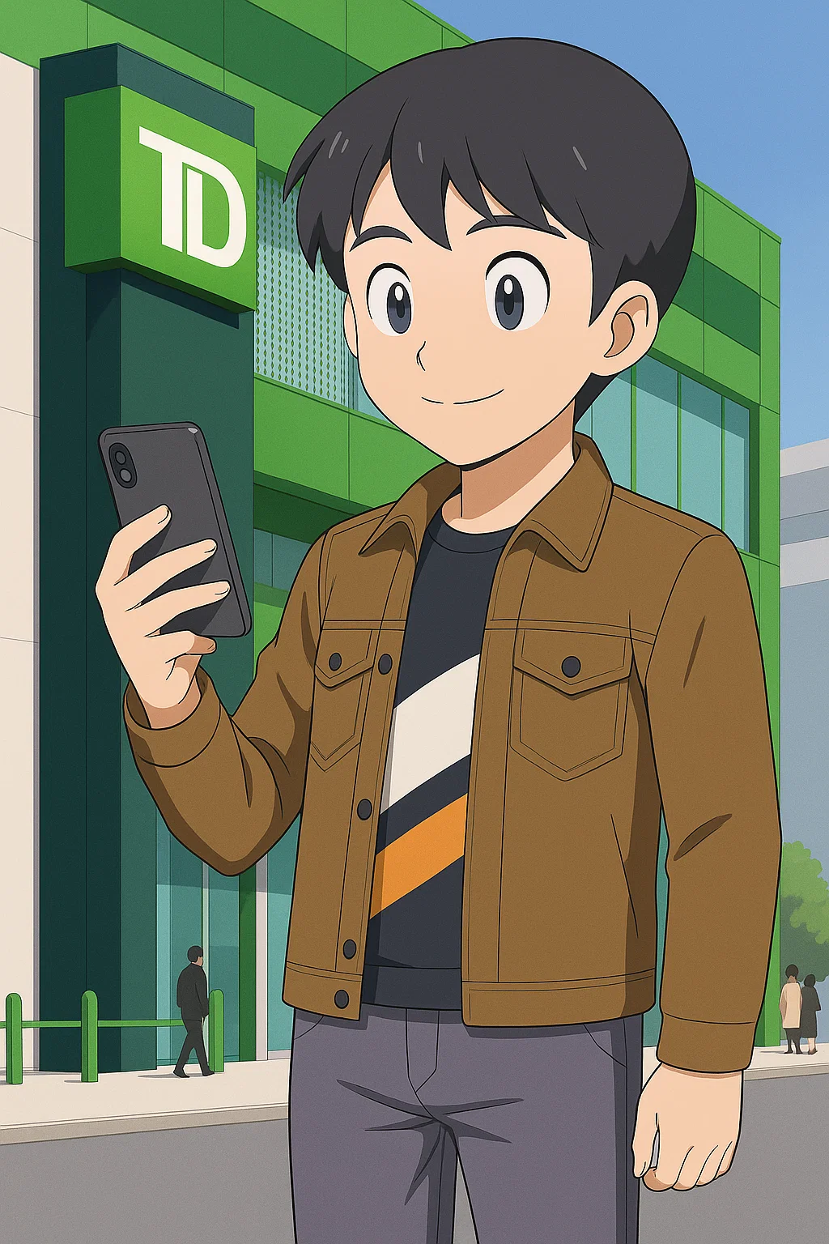
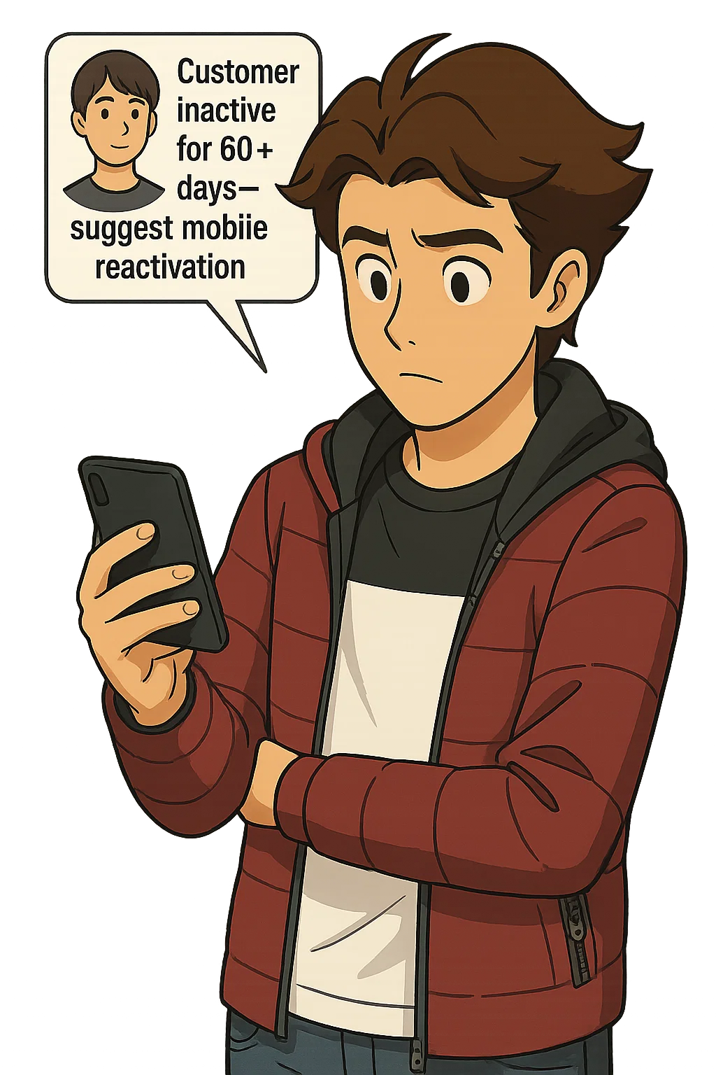
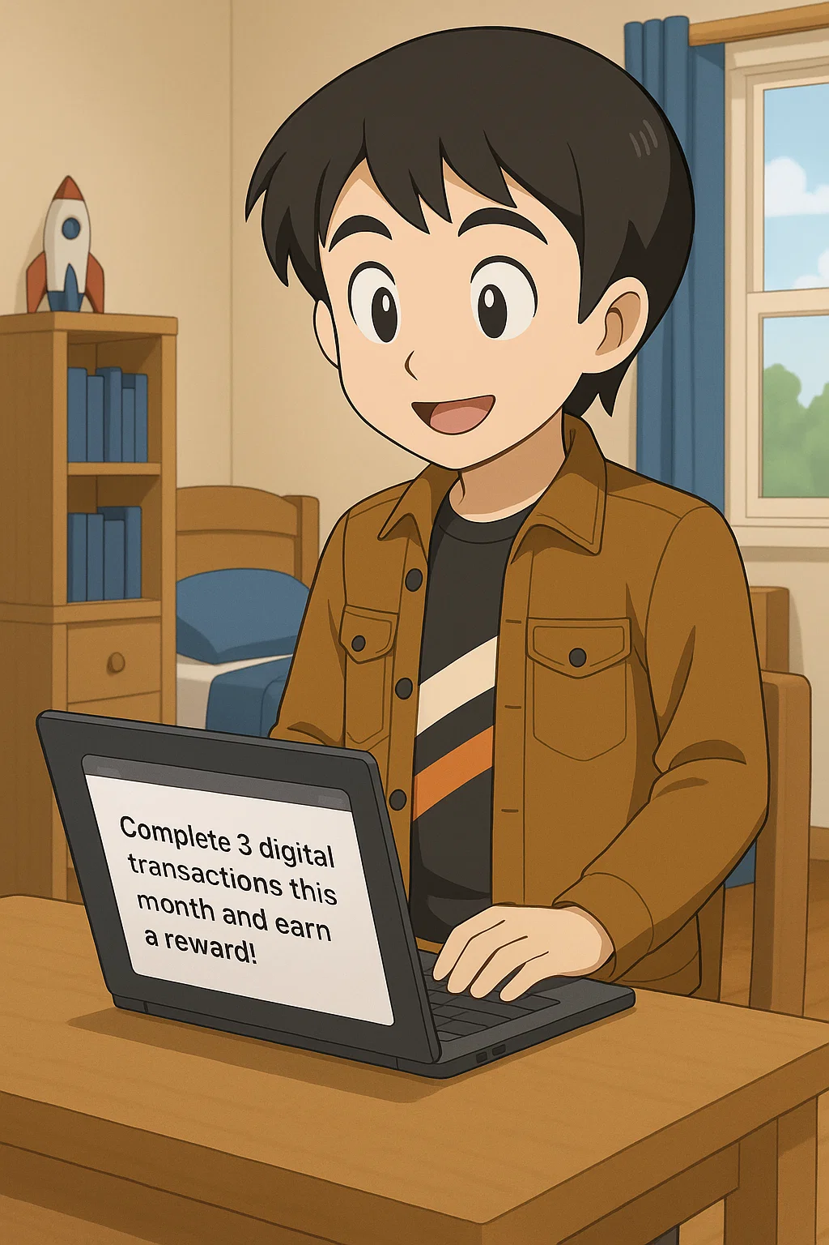

ChimeIn | Dormant Digital Users
Meet Marcus - Marcus is a Millennial sales consultant who used to rely on the mobile app—but after switching phones and getting busy, he hasn’t logged in for over two months. Instead, he’s been doing everything at the branch out of habit.
1
3
6
 | https://sora.chatgpt.com/g/gen_01 jvwrf811f4btq74ds0rnqmt0 |  | Marcus is reintroduced to the mobile app during his branch visit He accepts the challenge and completes digital tasks over the next few days Digital Readiness Score increases, moving Marcus back into a digital-first segment Branch visits decrease, easing traffic for simple tasks + Data & Analytics
Marcus visits the Branch…
Riley receives a notification…
You know, you can skip these visits if you use the app — want me to show you how?
4
The system surfaces the context to the concierge through ChimeIn
The concierge shows Marcus how to reenable his app …
Later that day…
5
ChimeIn alerts the concierge…
7
Marcus receives an email …
2
Marcus has not logged into the app for more than 60 days…
Marcus feels recognized and rewarded, boosting satisfaction and retention
The concierge approaches Marcus
Notes:
Marcus hasn’t used the mobile app in over 60 days and has returned to doing everything in person. When he visits the branch, the Model Context Protocol (MCP) identifies him as a dormant digital user.
The AI business rules engine automatically triggers a mobile greeting:
“Welcome back, Marcus. Want to explore 3 time-saving things you can do on the app before you leave?”
At the same time, the concierge is alerted with this context. They offer to help Marcus reinstall and reconnect his app, showing him how to resume digital use.
Later, Marcus receives a follow-up email with a digital challenge. He completes it over a few days.
💡 Outcomes:
Marcus is nudged back into digital engagement
His Digital Readiness Score (DRS) improves
Branch visits decrease for simple tasks
He feels supported, not pushed—increasing trust and retention

Slide 3

Chime
evokes push notifications
and presence detection
In
implies
authentication
Smart Nudging Orchestration
26th May 2025
Blitz Brigade
Rupa Iyer, Robert Mati, Janakan Senthilkumar Anthony D'Costa, Jelena Tucci, June Patridge
Notes:
ChimeIn proves that the future of banking is not just open — it's ready to welcome you. By combining MCP with AI-driven nudging, we deliver personalized, efficient, and data-backed experiences that uplift service, reduce costs, and boost satisfaction. Presented by the Blitz Brigade: Rupa Iyer, Robert Mati, Janakan Senthilkumar, Anthony D’Costa, Jelena Tucci, and June Patridge.

